Slide 1
Homework 1 Presentation
Group 2: Shiyu FAN (Leo)
Runhai XU (James)
Zhaohang YAN (Martin)
Notes:
Good afternoon everyone. I‘m Martin from Group 2. Today I’m going to share the results we obtained while we exploring the web scraping this week.

Slide 2

The data we are interested in:
We are interested in visualizing the data of movies so that we can understand the overall trends and do some data analysis of the movie industry.
We chose IMDb (Internet Movie Database) to get the movie data we want.
There are tons of movie data in IMDb. We only want to focus on comedy films. We retrieved data of ~450,000 comedy movies from IMDb to do further analysis.

Slide 3
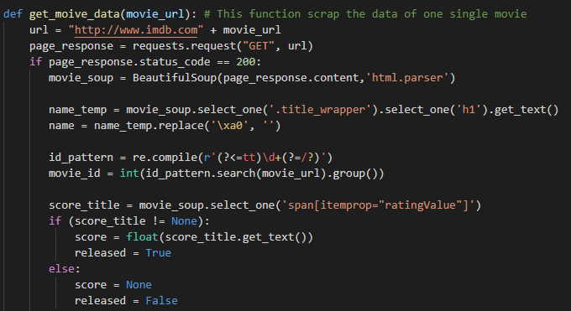
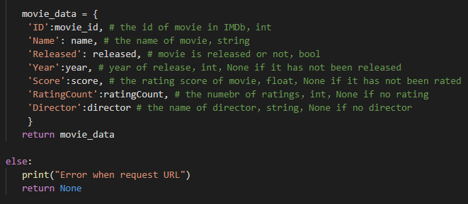
How we retrieve the data
Use bs4 (BeautifulSoup) library to parse the HTML web page.
Notes:
So this is the function we wrote to obtain the data of a single movie. As you can see, we have a variable named movie_soup. We then do a series of steps to get the data we want. Then we store the data in a python dictionary.

Slide 4
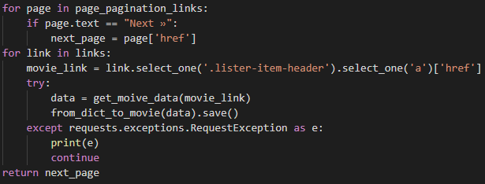
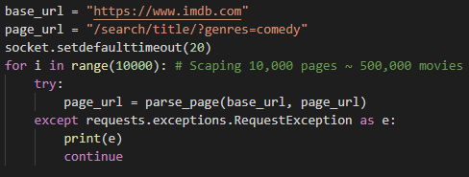
Errors/Exceptions handling:
While we were scraping the data from IMDb, we encountered some request exceptions that terminate our web scraping program since we requested too frequently.
Therefore, we use try/except keywords to catch the exception and continue to the next iteration so that the program will not be terminated.
We also extended the default timeout time of socket to avoid exceptions.

Slide 5
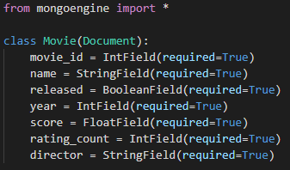
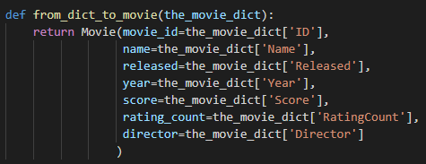
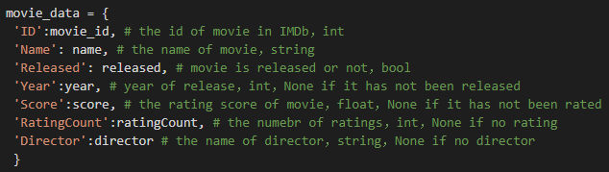

Inspect our database:
Notes:
We creates Movie class to define a single Movie object that is going to be stored in the database. The function from_dict_to_movie converts python dictionary object to a Movie object we declared before so that we can store it into our MongoDB. Here’s the documentation of our movie_data. So each Movie object has a unique id. It has name, released or not. The year of release, the rating score, the number of ratings, and the director of the movie. This is how we interact with our database and store each Movie object to it.

Slide 6
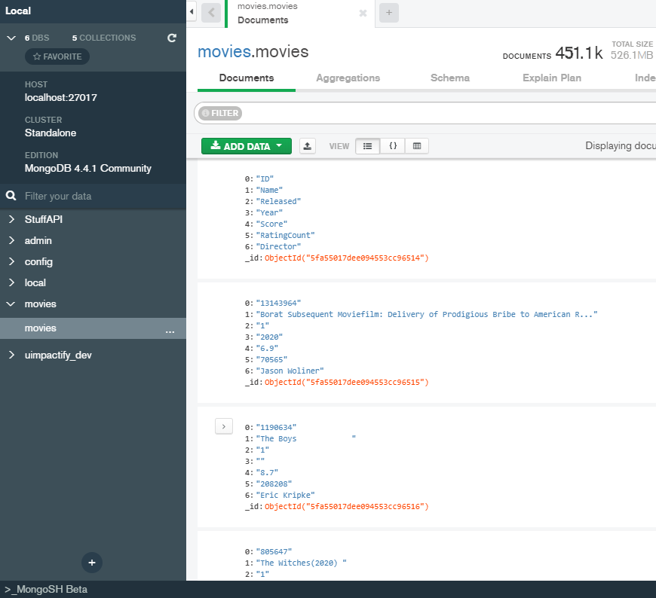
Inspect our database:
We use MongoDB to store our data.
The database has ~451,100 movies and the size of them is 526.1 MB.
We use MongoDB Compass to interact with the database.
Notes:
Here’s a peek of the information of our MongoDB database. …………….. We use MongoDB Compass to interact with the database. It provides a graphical user interface (GUI) so that it will be easier to do the database operations.

Slide 7
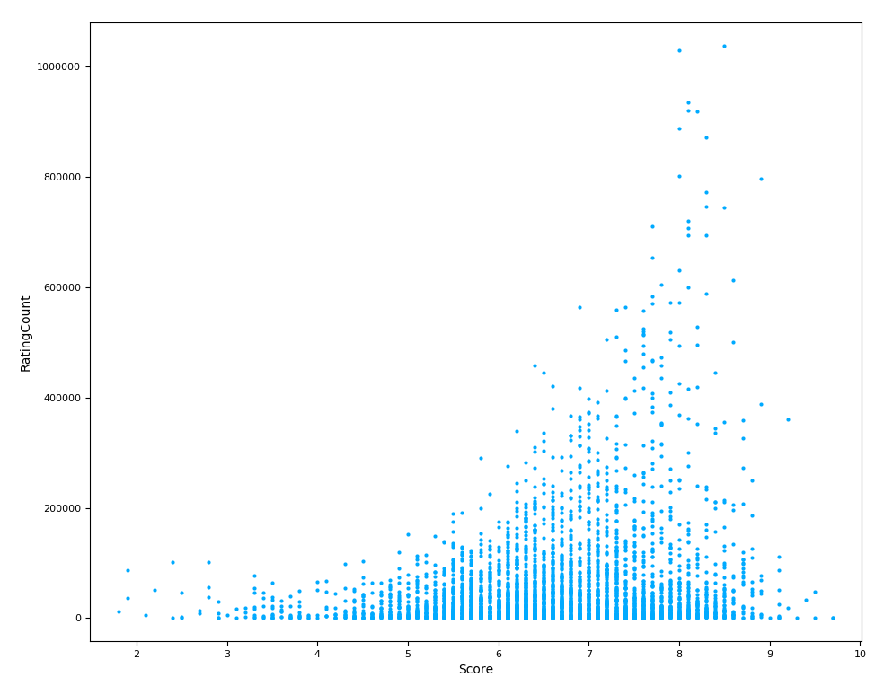
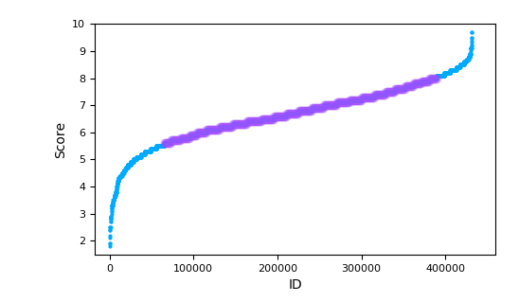
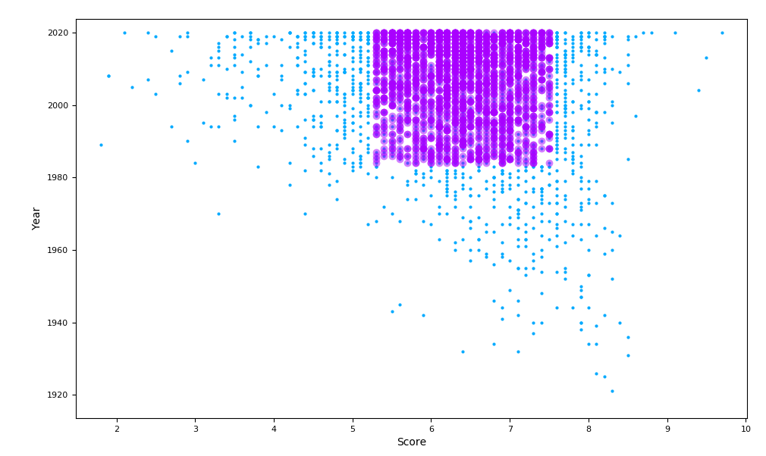
Data Visualization:
Notes:
Moving on to the data visualization. The first graph on the left shows the general distribution of the movie scores. Most of the comedy movies in our database are distributed between 5.5 points and 8 points. There are about 300,000 of them. The graph on the upper right corner shows that the number of ratings for most of the movies are under 200,000. The purple section in the last graph shows that the majority of movies released between 1980 and 2020 have scores from 5 to 8.

Slide 8
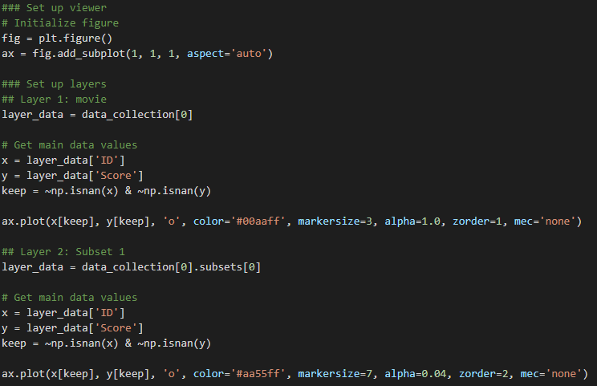
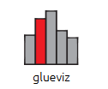
How did we create such MAGICAL plotting:
With help of matplotlib and glueviz libraries/packages, we construct such informative graph showing the relationships within the database.

